Slide 1



Welcome to
CS 345 Operating Systems
Concurrency, Chapter 6 (14)

Slide 2
Tip #14: Calculate Elapsed Time
To calculate the time passed between two events without taking extra execution time than expected:
#include <time.h>
#include <stdlib.h>
clock_t startm, stopm;
#define BEGIN if ((startm = clock()) == -1) { exit(1); }
#define CLOSE if ((stopm = clock()) == -1) { exit(2); }
#define SHOWTIME printf("%6.3f seconds elapsed.", \
((double)stopm-startm)/CLOCKS_PER_SEC);
int main()
{
BEGIN;
// Instructions to time.
Sleep(10);
CLOSE;
SHOWTIME;
}

Slide 3
P2 Passoff
myOS345 - Roper Jul 16 2021
E:\CS345\os345F2021\os345 F2021.exe
0>>sem
task0 B 0 myShell
deltaClockChange B 0 myShell
deltaClockMutex B 1 myShell
tics10sec C 1 myShell
tics10thsec B 1 myShell
tics1sec B 1 myShell
keyboard B 1 myShell
inBufferReady B 0 myShell
charReady B 1 myShell
2>>sem
task0 B 0 myShell
deltaClockChange B 0 myShell
deltaClockMutex B 1 myShell
tics10sec C 3 myShell
tics10thsec B 1 myShell
tics1sec B 1 myShell
keyboard B 1 myShell
inBufferReady B 0 myShell
charReady B 1 myShell
4>>p2
Starting Project 2
I'm task[1] timerTask1 and the time is Thu Sep 30 22:34:57 2021
I'm task[1] timerTask1 and the time is Thu Sep 30 22:34:57 2021
I'm task[1] timerTask1 and the time is Thu Sep 30 22:34:57 2021
34>>
(12) I'm Alive!
(13) I'm Alive!
I'm task[1] timerTask1 and the time is Thu Sep 30 22:34:59 2021lt
0/0 myShell 5 Running
1/0 timerTask1 15 Blocked tics10sec
2/0 timerTask2 15 Blocked tics10sec
3/0 timerTask3 15 Blocked tics10sec
4/0 timerTask4 15 Blocked tics10sec
5/0 timerTask5 15 Blocked tics10sec
6/0 timerTask6 15 Blocked tics10sec
7/0 timerTask7 15 Blocked tics10sec
8/0 timerTask8 15 Blocked tics10sec
9/0 timerTask9 15 Blocked tics10sec
10/0 signal1 20 Blocked s1Sem
11/0 signal2 20 Blocked s2Sem
12/0 I'm Alive 1 Ready
13/0 I'm Alive 1 Ready
155505>>sem
task13 B 0 myShell
task12 B 0 myShell
s2Sem B 0 signal2
task11 B 0 myShell
s1Sem B 0 signal1
task10 B 0 myShell
task9 B 0 myShell
task8 B 0 myShell
task7 B 0 myShell
task6 B 0 myShell
task5 B 0 myShell
task4 B 0 myShell
task3 B 0 myShell
task2 B 0 myShell
task1 B 0 myShell
task0 B 0 myShell
deltaClockChange B 0 myShell
deltaClockMutex B 1 myShell
tics10sec C -9 myShell
tics10thsec B 1 myShell
tics1sec B 1 myShell
keyboard B 1 myShell
inBufferReady B 0 myShell
charReady B 1 myShell
228334>>
I'm task[2] timerTask2 and the time is Thu Sep 30 22:35:09 2021
run "sem", wait 20 seconds, run "sem"
note what the current value of tics10sec is and check that it is a counting semaphore.
check that tics10sec is 2 greater than at the start
wait 30+ seconds, run "p2", run "lt"
check that the first 10sec task consumes all 10sec semaphores
check that subsequent 10sec tasks then begin execution/priority order within each queue
run "sem", run "lt"
check that tics10sec is now -9 (9 tasks waiting on tics10sec)
check to make sure that each 10sec task is rotating properly (1 then 2 ... 9, then back to 1 ...)
check to make sure the the two AliveTasks are alternating properly (12 then 13 each time)
run "s1" 4 times, run "s2" 4 times
make sure it runs immediately each time
run "kill #" for each 10sec task pid, run "sem", run "lt"
verify count of tics10sec is now one less than previous (-8 the first time, -7 the next, and so on)
check that the specific killed task is indeed gone from the queue
run "kill -1", run "lt", run "sem"
check that all tasks beside shell are dead
check that tics10sec is 0 (or possibly 1 if the tic happened immediately after)

Slide 4

Delta Clock
Problem: How to efficiently monitor multiple timed events?
Examples of timed events:
scheduling
real-time sequencing
timers
timeouts
Lists require each event timer to be decremented (O(n)) to determine if time has expired.
Using a Delta Clock only requires decrementing the top entry (O(1)).

Slide 5
DC Implementation
Notice that Event1 occurs 15 tics after Event2
Suppose:
Event1 occurs in 20 tics
Event2 occurs in 5 tics
Event3 occurs in 35 tics
Event4 occurs in 27 tics
Event 5 occurs in 27 tics
Event 6 occurs in 22 tics
20
Event1
5
Event2
5
Event2
35
Event3
12
Event7
5
Event2
3
Event1
12
Event7
5
Event2
27
Event4
2
Event6
3
Event1
15
Event1
5
Event4
2
Event6
2
Event6
27
Event5
0
Event5
5
Event4
5
Event4
And that Event6 occurs 2 tics after Event1
4
Event8
0
Event5
0
Event5
4
Event3
22
Event6
8
Event3
8
Event3
Linked List
Delta Clock
What if Event7 occurs in 17 tics?
Event8 in 31 tics?

Slide 6
Step 1: Delta Clock
Implement delta clock.
Design data structure to hold delta times/events.
Program an insert delta clock function
insertDeltaClock(int time, Semaphore* sem);
High priority, mutex protected
Add 1/10 second function to decrement top event and semSignal semaphore when 0
pollinterrupts or
High priority, mutex protected.
dc[5]
dc[4] | 10 / sem1
dc[3] | 5 / sem2
dc[2] | 0 / sem3
dc[1] | 2 / sem4
dc[0] | 4
Thoroughly test the operation of your delta clock before proceeding.
os345p3.c
Print Delta Clock (dc): int P3_dc(int argc, char* argv[]);
Test Delta Clock (tdc): int P3_tdc(int argc, char* argv[]);
int dcMonitorTask(int argc, char* argv[]);
int timeTask(int argc, char* argv[]);

Slide 7

Chapter 6 Concurrency: Deadlock and Starvation

Slide 8
CS 345
Stalling’s Chapter | # | Project
1: Computer System Overview 2: Operating System Overview | 4 | P1: Shell
3: Process Description and Control 4: Threads | 4 | P2: Tasking
5: Concurrency: ME and Synchronization 6: Concurrency: Deadlock and Starvation | 6 | P3: Jurassic Park
7: Memory Management 8: Virtual memory | 6 | P4: Virtual Memory
9: Uniprocessor Scheduling 10: Multiprocessor and Real-Time Scheduling | 6 | P5: Scheduling
11: I/O Management and Disk Scheduling 12: File Management | 8 | P6: FAT
Student Presentations | 6

Slide 9
Learning Objectives…
Learning Outcomes
After completing this section, you should be able to
List and explain the conditions of deadlock.
Define deadlock prevention and describe deadlock prevention strategies related to each of the conditions for deadlock.
Explain the difference between deadlock prevention and deadlock avoidance.
Understand how an integrated deadlock strategy can be designed.
Analyze the dining philosophers problem.
Explain the concurrency and synchronization methods used in UNIX, Linux, Solaris, and Windows 7.
Topics
Resources
Deadlock
Joint Process Diagrams
Deadlock Conditions
Circular Wait
Resource Allocation Graph
Handling Deadlock
Avoidance
Detection
Recovery

Slide 10
Memory Allocation
How could deadlock occur when
200K bytes of memory is available for allocation by the system
Process 1 needs 140K in 80K, 60K blocks
Process 2 needs 150k in 70K, 80K blocks
Process 1
Request 80K bytes
…
Request 60K bytes
…
Process 2
…
Request 70K bytes
…
Request 80K bytes
How could deadlock occur when
Two processes need to communicate via send/receive messages
Process 1 waits to hear from process 2 before sending data
Process 2 proceeds after hearing from process 1
Process 1
Receive(P2)
…
Send(P2)
…
Process 2
…
Receive(P1)
…
Send(P1)
Notes:
10

Slide 11
Types of Resources
Reusable Resources
Used by one process at a time and not depleted by that use
Processes obtain resources that they later release for reuse by other processes
Processor time, I/O channels, main and secondary memory, files, databases, and semaphores
Deadlock occurs if each process holds one resource and requests the other
Consumable Resources
Created (produced) and destroyed (consumed) by a process
Interrupts, signals, messages, and information in I/O buffers
Deadlock may occur if a Receive message is blocking
May take a rare combination of events to cause deadlock
Notes:
11

Slide 12
Follow the Rules…
System Model (Rules)
Process must request (and be granted) a resource before using it.
Process must release the resource when done.
Why??
Deadlock
A set of processes is in a deadlock state when every process in the set is waiting for an event that can only be caused by another process in the set.
P1: holds R1, needs R2
P2: holds R2, needs R3
P4: needs R1
P3: holds R3, needs R1
Notes:
12

Slide 13
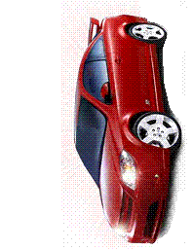







Traffic Congestion Problems
What are the resources?
Where is mutual exclusion needed?
What is required for deadlock to occur?
Notes:
13

Slide 14
Traffic Congestion Problems
What are the resources?
Where is mutual exclusion needed?
What is required for deadlock to occur?
ME
Notes:
14

Slide 15
Joint Process Diagram
Progress
of Q
1
2
Impossible joint
conditions are
grayed out.
Release A
Both P and Q
have A
A
Required
Release B
Get A
B
Required
5
?
Both P and Q
have B
P has B
Q has A
P has B
Q has A
4
Get B
Deadlock is only inevitable if the joint progress of the two processes creates a path that enters the fatal region.
6
3
Progress
of P
Get A
Get B
Release A
Release B
A Required
B Required
Notes:
15

Slide 16
Joint Process Diagram
Progress
of Q
1
2
3
Release
A
Both
P and Q
have A
6
A
Required
Release
B
Get A
Both
P and Q
have B
B
Required
5
Get B
4
Progress
of P
Get A
Release A
Get B
Release B
No fatal region, as there are “exit” paths available.
A
Required
B
Required
Notes:
16

Slide 17
Conditions of Deadlock
Necessary (but not sufficient)
Mutual exclusion – Everyone abides by the rules
only one process may use a resource at a time.
no process may access resource allocated to another.
Hold-and-wait
a process may hold allocated resources while awaiting assignment of other resources.
No preemption
no resource can be forced to free a resource.
Circular wait (sufficient)
a closed chain of processes exists, such that each process holds at least one resource needed by the next process in the chain (consequence of the first three conditions)
Other conditions are necessary but not sufficient for deadlock - all four conditions must hold for deadlock - Unresolvable circular wait is the definition of deadlock!
Notes:
17

Slide 18
Circular Wait
Resource
A
Requests
Held by
Process
P1
Process
P2
Held By
Requests
Resource
B
Notes:
18

Slide 19
Resource Allocation Graph
R1
R2
Deadlocks can be described using resource allocation graph.
Vertices: circles are Processes, rectangles are Resources.
P1
P2
P3
A directed edge from Pi to Rj indicates process Pi has requested an instance of resource Rj
R3
A directed edge from Rj to Pi indicates resource Rj has been allocated to process Pi
R4
Notes:
19

Slide 20
Resource Allocation Graph
R1
R2
Is there a cycle (ie. some number of vertices connected in a closed chain)?
P1
P2
P3
If a graph contains no cycles, then no process in the system is deadlocked.
If the graph contains a cycle, deadlock MAY exist.
R3
Yes
Is there deadlock?
R4
Notes:
20

Slide 21
Deadlock?
P2
Is there a cycle?
Yes
R1
P1
P3
Is there deadlock?
No
R2
P4
Notes:
21

Slide 22
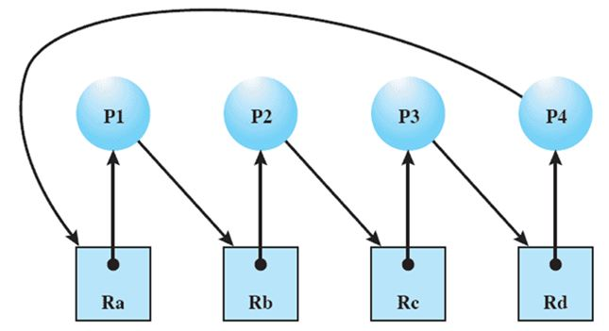
Traffic Intersection

Slide 23
Handling Deadlock
Four general approaches exist for dealing with deadlock.
Prevent deadlock
by adopting a policy that eliminates one of the conditions.
Avoid deadlock
by making the appropriate dynamic choices based on the current state of resource allocation.
Detect Deadlock
by checking whether conditions 1 through 4 hold and take action to recover.
Ignore Deadlock
System may hang, so??
Notes:
23

Slide 24
1. Prevent Deadlock
Eliminate Mutual Exclusion
Use non-sharable resources
Eliminate Hold and wait
Guarantee that when a process requests a resource, it does not hold any other resources
System calls requesting resources precede all others
A process can only request resources when it has none
Usually results in low utilization of resources
Allow Preemption
If a process holds resources and requests more that cannot be allocated, all its other resources are preempted
If you can’t hold all, you can’t hold any
Process is restarted only when it can have all
Works for resources whose state can be easily saved and restored later such as registers or memory.
Notes:
24

Slide 25
1. Prevent Deadlock
Eliminate Circular Wait
Impose a total ordering of all resources (transitivity, antisymmetry)
Require that all processes request resources in increasing order.
Whenever a process requests a resource, it must release all resources that are lower
With this rule, the resource allocation graph can never have a cycle.
May be impossible to find an ordering that satisfies everyone
1 ≡ Card reader
2 ≡ Printer
3 ≡ Plotter
4 ≡ Tape drive
5 ≡ Card punch
Processes request resources whenever, but must be made in numerical order.
A process may request first printer and then a tape drive (order: 2, 4), but not a plotter and then a printer (order: 3, 2).
Notes:
25

Slide 26
2. Avoid Deadlock
Allow general requests, but grant only when safe
Assume we know the maximum requests (claims) for each process
Process must state it needs
Ie. max of 5 A objects, 3 B objects, 2 C objects.
Do not need to use its max claims
Ie. Ok to set max=5 and only use 3
Can make requests at any time and in any order
Process Initiation Denial
Track current allocations
Assume all processes may make maximum requests at the same time
Only start process if it can’t result in deadlock regardless of allocations
Notes:
26

Slide 27
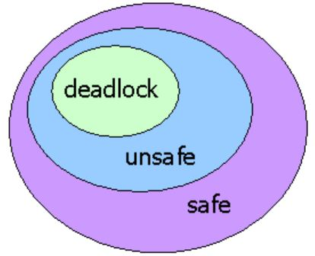
Resource Allocation Denial
Safe State – We can finish all processes by some scheduling sequence
Example: Finish P1, P4, P2, P5, P3
Banker’s Algorithm (Dijkstra)
Reject a request if it exceeds the
processes’ declared maximum claims
Grant a request if the new state would be safe
Determining if a state is safe
Find any process P_{i} for which we can meet it’s maximum requests
Don't forget already allocated resources
Mark P_{i} as “done”, add its resources to available resource pool
State is safe if we can mark all processes as “done”
Block a process if the resources are not currently available or the new state is not safe
Notes:
27

Slide 28
Banker’s Algorithm Example
Claim
Allocation
Allocation
C - A
 | A | B | C
P₁ | 3 | 2 | 2
P₂ | 6 | 1 | 3
P₃ | 3 | 1 | 4
P₄ | 4 | 2 | 2
A
A
B
C
A
B
B
C
C
P₁
P₁
2
2
2
P₁
1
1
0
0
0
0
P₂
P₂
1
0
2
P₂
5
5
1
1
1
1
P₃
P₃
1
0
3
P₃
2
2
1
1
1
1
P₄
P₄
4
2
0
P₄
0
0
0
0
2
2
Resource
A | B | C
9 | 3 | 6
Available
A | B | C
1 | 1 | 2
6 | 2 | 3
Are we in a safe state?
Yes!

Slide 29
XYZ Carpentry
Carpentry Company XYZ has 4 employees, 9 clamps, 2 drills, and 2 bottles of glue.
Chair 4 clamps, 1 drill
Desk 6 clamps, 1 drill, 1 glue
Picture Frame 4 clamps, 1 drill, 1 glue
Book Case 6 clamps, 1 drill, 1 glue

Slide 30
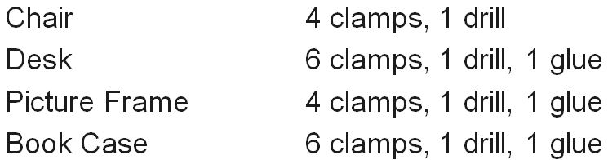
XYZ Carpentry
Claim
Allotted
Needed
 | Clamp | Drill | Glue
P₁ | 4 | 1 | 0
P₂ | 6 | 1 | 1
P₃ | 4 | 1 | 1
P₄ | 6 | 1 | 1
 | Clamp | Drill | Glue
P₁ | 1 | 0 | 0
P₂ | 2 | 0 | 1
P₃ | 2 | 1 | 0
P₄ | 2 | 0 | 0
A
B
C
P₁
3
1
0
P₂
4
1
0
P₃
2
0
1
P₄
4
1
1
Resource
Clamp | Drill | Glue
9 | 2 | 2
Available
Clamp | Drill | Glue
2 | 1 | 1
4 | 2 | 1
Yes!
1. Are we in a safe state?
2. P₁ needs a drill. Is it OK to give it to him?
3. Then, P₄ needs a glue. Would you give it to him?

Slide 31
XYZ Carpentry
Claim
Allotted
Needed
 | Clamp | Drill | Glue
P₁ | 4 | 1 | 0
P₂ | 6 | 1 | 1
P₃ | 4 | 1 | 1
P₄ | 6 | 1 | 1
 | Clamp | Drill | Glue
P₁ | 1 | 1 | 0
P₂ | 2 | 0 | 1
P₃ | 2 | 1 | 0
P₄ | 2 | 0 | 0
A
B
C
P₁
3
0
0
P₂
4
1
0
P₃
2
0
1
P₄
4
1
1
Resource
Clamp | Drill | Glue
9 | 2 | 2
Available
Clamp | Drill | Glue
2 | 0 | 1
4 | 2 | 1
Yes!
1. Are we in a safe state?
2. P₁ needs a drill. Is it OK to give it to him?
3. Then, P₄ needs a glue. Would you give it to him?
Yes!

Slide 32
XYZ Carpentry
Claim
Allotted
Needed
 | Clamp | Drill | Glue
P₁ | 4 | 1 | 0
P₂ | 6 | 1 | 1
P₃ | 4 | 1 | 1
P₄ | 6 | 1 | 1
 | Clamp | Drill | Glue
P₁ | 1 | 1 | 0
P₂ | 2 | 0 | 1
P₃ | 2 | 1 | 0
P₄ | 2 | 0 | 0
A
B
C
P₁
3
0
0
P₂
4
1
0
P₃
2
0
1
1
P₄
4
1
1
0
Resource
Clamp | Drill | Glue
9 | 2 | 2
Available
Clamp | Drill | Glue
2 | 0 | 1
2 | 0 | 0
1. Are we in a safe state? Yes
2. P₁ needs a drill. Is it OK to give it to him? Yes
3. Then, P₄ needs a glue. Would you give it to him?
No!

Slide 33
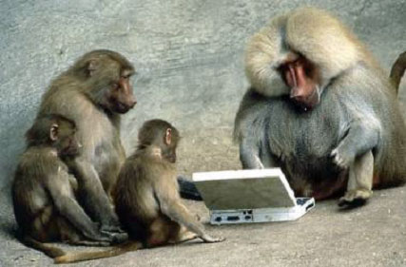

Be Safe

